Slide 1
Decision Threshold

Slide 2
AI in decision Making: Using ML to make yes/no decisions about taking a given action

Slide 3
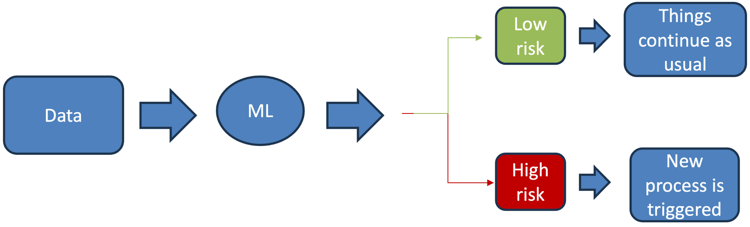
Typical ML opportunity in business

Slide 4
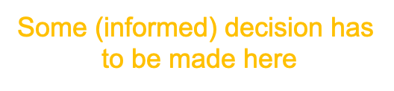
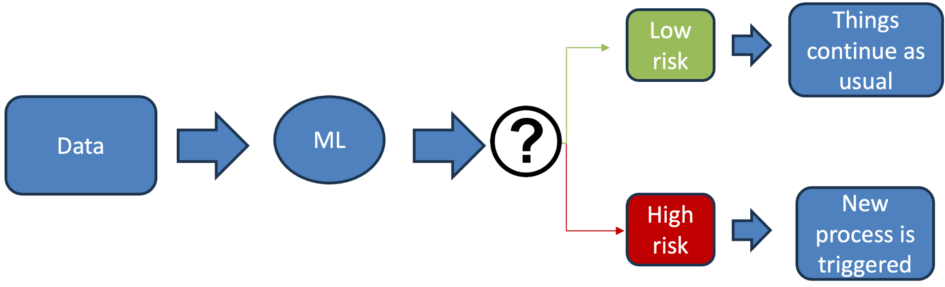
Typical ML opportunity in business
risk

Slide 5
Rank Score Label
1 0.997 1
2 0.993 1
3 0.986 1
4 0.982 1
5 0.971 0
6 0.965 1
7 0.964 0
8 0.961 0
9 0.953 0
10 0.932 1
11 0.918 0
12 0.873 0
13 0.854 0
14 0.839 0
15 0.777 0
16 0.723 0
17 0.634 0
18 0.512 0
19 0.487 0
20 0.473 0
Total Label Positives: 6
Total Label Negatives: 14
Prevalence: 6/20 = 0.3

Slide 6
Rank Score Label
1 0.997 1
2 0.993 1
3 0.986 1
4 0.982 1
5 0.971 0
6 0.965 1
7 0.964 0
8 0.961 0
9 0.953 0
10 0.932 1
11 0.918 0
12 0.873 0
13 0.854 0
14 0.839 0
15 0.777 0
16 0.723 0
17 0.634 0
18 0.512 0
19 0.487 0
20 0.473 0
Total Label Positives: 6
Total Label Negatives: 14
Prevalence: 6/20 = 0.3
Predicted Positive: 4
Predicted Negative: 16
For threshold > 0.980 or top k = 4
True Positives: 4
False Positives : 0
False Negatives : 2
True Negatives : 14
Notes:
O modelo é o mesmo, decidimos é uma forma de o avaliar escolhendo uma threshold.
Escolhemos os topk examples como classe positive

Slide 7
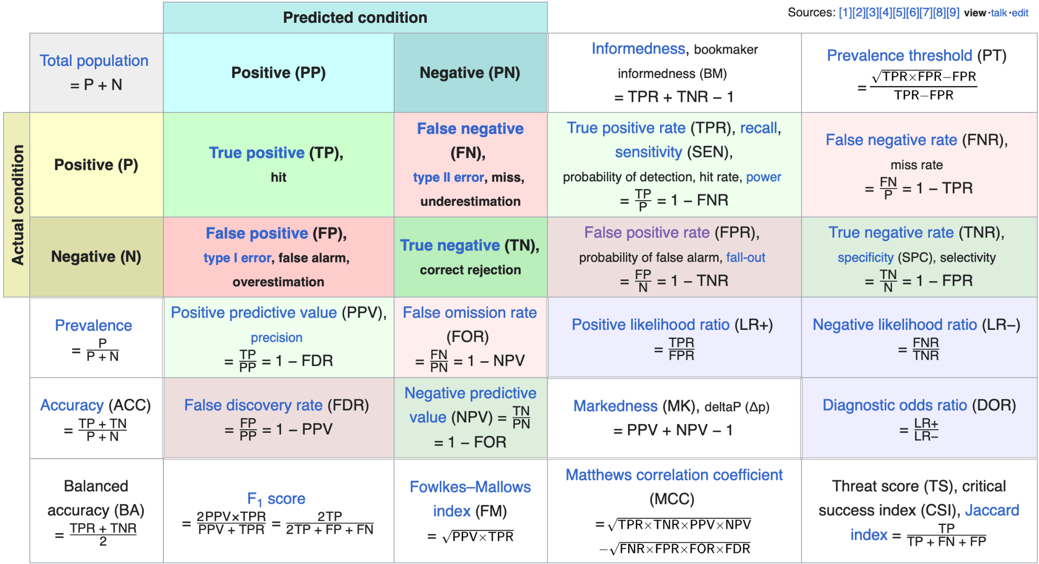
source: https://en.wikipedia.org/wiki/Receiver_operating_characteristic

Slide 8
Probabilistic Interpretation
True Positive Rate (Recall) = P( Predicted Positive | Actual Positive)
Positive Predicted Value (PPV) (Precision) = P( Actual Positive | Predicted Positive)
False Positive Rate (FPR) = P( Predicted Positive | Actual Negative)
False Negative Rate (FNR) = P( Predicted Negative | Actual Positive)
False Discovery Rate (FDR) = P( Actual Negative | Predicted Positive) = 1 - PPV
False Omission Rate (FOR) = P( Actual Positive | Predicted Negative)
True Negative Rate (TNR) = P (Predicted Negative | Actual Negative)

Slide 9
Rank Score Label
1 0.997 1
2 0.993 1
3 0.986 1
4 0.982 1
5 0.971 0
6 0.965 1
7 0.964 0
8 0.961 0
9 0.953 0
10 0.932 1
11 0.918 0
12 0.873 0
13 0.854 0
14 0.839 0
15 0.777 0
16 0.723 0
17 0.634 0
18 0.512 0
19 0.487 0
20 0.473 0
Total Label Positives: 6
Total Label Negatives: 14
Prevalence: 6/20 = 0.3
Predicted Positive: 4
Predicted Negative: 16
For threshold > 0.980 or top k = 4
True Positives: 4
False Positives : 0
False Negatives : 2
True Negatives : 14
False Positive Rate: 0/14 = 0
Recall: 4/6 = 0.66
False Negative Rate: 2/6 = 0.33
Precision = 4/4 = 1.0

Slide 10
Rank Score Label
1 0.997 1
2 0.993 1
3 0.986 1
4 0.982 1
5 0.971 0
6 0.965 1
7 0.964 0
8 0.961 0
9 0.953 0
10 0.932 1
11 0.918 0
12 0.873 0
13 0.854 0
14 0.839 0
15 0.777 0
16 0.723 0
17 0.634 0
18 0.512 0
19 0.487 0
20 0.473 0
Total Label Positives: 6
Total Label Negatives: 14
Prevalence: 6/20 = 0.3
For threshold > 0.920 or top k = 10
True Positives: 6
False Positives : 4
False Negatives : 0
True Negatives : 10
False Positive Rate: 4/14 = 0.29
Recall: 6/6 = 1.0
False Negative Rate: 0/6 = 0
Precision = 6/10 = 0.6
Predicted Positive: 10
Predicted Negative: 10
Notes:
Isto pode ser um processo de entrevista, por isso se calhar em vez de top 4 consegues entrevistar mais candidatos então podemos escolher top 10

Slide 11
Not all instances are the same…

Slide 12
Overall
Total Label Positives: 6
Total Label Negatives: 14
Prevalence: 6/20 = 0.3
Non-White
Total Label Positives: 3
Total Label Negatives: 6
Group size: 9
Prevalence: 0.33
White
Total Label Positives: 3
Total Label Negatives: 8
Group size: 11
Prevalence: 0.27
Overall
Total Label Positives: 6
Total Label Negatives: 14
Prevalence: 6/20 = 0.3
Rank Score Label Skin Color
1 0.997 1 non-white
2 0.993 1 white
3 0.986 1 white
4 0.982 1 non-white
5 0.971 0 white
6 0.965 1 white
7 0.964 0 white
8 0.961 0 non-white
9 0.953 0 non-white
10 0.932 1 non-white
11 0.918 0 non-white
12 0.873 0 white
13 0.854 0 white
14 0.839 0 white
15 0.777 0 white
16 0.723 0 non-white
17 0.634 0 white
18 0.512 0 non-white
19 0.487 0 white
20 0.473 0 non-white
Rank Score Label
1 0.997 1
2 0.993 1
3 0.986 1
4 0.982 1
5 0.971 0
6 0.965 1
7 0.964 0
8 0.961 0
9 0.953 0
10 0.932 1
11 0.918 0
12 0.873 0
13 0.854 0
14 0.839 0
15 0.777 0
16 0.723 0
17 0.634 0
18 0.512 0
19 0.487 0
20 0.473 0
Notes:
Esta análise é independente se incluiste a feature ou não no modelo
Um grupo é maior mas a prevalencia é maior no grupo mais pequeno

Slide 13
Rank Score Label Skin Color
1 0.997 1 non-white
2 0.993 1 white
3 0.986 1 white
4 0.982 1 non-white
5 0.971 0 white
6 0.965 1 white
7 0.964 0 white
8 0.961 0 non-white
9 0.953 0 non-white
10 0.932 1 non-white
11 0.918 0 non-white
12 0.873 0 white
13 0.854 0 white
14 0.839 0 white
15 0.777 0 white
16 0.723 0 non-white
17 0.634 0 white
18 0.512 0 non-white
19 0.487 0 white
20 0.473 0 non-white
Overall
Total Label Positives: 6
Total Label Negatives: 14
Prevalence: 6/20 = 0.3
Non-White
Total Label Positives: 3
Total Label Negatives: 6
Group size: 9
Prevalence: 0.33
White
Total Label Positives: 3
Total Label Negatives: 8
Group size: 11
Prevalence: 0.27
Predicted Positive: 10
Predicted Negative: 10
White
True Positives: 3 FPR: 2/8 = 0.25
False Positives: 2 Recall: 3/3 = 1.0
False Negatives: 0 Precision: 3/5 = 0.6
True Negatives: 6 FNR = 0
Non-White
True Positives: 3 FPR: 2/6 = 0.33
False Positives: 2 Recall: 3/3 = 1.0
False Negatives: 0 Precision: 3/5 = 0.6
True Negatives: 4 FNR = 0
Notes:
Sabendo que é non-white e a label é zero, a probabilidade de dar um False Positive é maior do que se a label for White.

Slide 14
Is the previous difference in False Positive Rates between white and non-white a problem?

Slide 15
Is the previous difference in False Positive Rates between white and non-white a problem?
It depends on the action/intervention
Notes:
Se estou a dar ajuda, e a baseline é não tens ajuda mas uns subgrupos acabam por ter mais alguma ajuda que outros, não é super grave.
Há um custo de oportunidade porque o budget se o budget é limitado, vamos estar a gastar budget para pessoas que não precisam de ajuda (imaginem uma intervenção de saúde ou social ou de educação).
Mas all in all não é super grave receberes uma intervenção quando não precisas.
Mas se a intervenção é punitiva como ser acusado num sistema criminal, então a história é muito diferente. Ou seres negado um empréstimo.

Slide 16
Bias in Decision-Making
Decision making is about predictions. There will be errors: false positives and false negatives
Bias is about disparate errors against specific sub-groups.
Decision-Making has been around for thousands of years. Bias as well
Notes:
Sempre que há decisões políticas, há sempre alguns grupos de pessoas que recebem mais benefícios que outras, e pessoas que são mais injustiçadas que outras. (decisões económicas que cortam mais a uns que outros).
AUC não ajuda em nada em decision-making. Porque é uma medida geral de performance. Na realidade, em produção, tens sempre que decidir uma threshold e estás preocupado com precision e recall. Portanto é comum otimizar para esta métrica global (ou average precision) e depois num set de validação encontrar a threshold que faz sentido para o business case.
Algo que não é óbvio, é que dois modelos com performance global semelhante (e.g. auc-roc) podem divergir bastante na desigualdade de erros.
E portanto ao trabalhar em ML e criar sistemas para automatizar decision-making, não pensamos no impacto desta parte de bias. Especialmente se algo é completamente automatizado sem haver human labellers a olhar para os dados, então estamos a criar um feedback loop

Slide 17
Sources of Bias
World
People
Data
Sample
Label
Machine Learning Pipeline (Decisions)
Actions
Notes:
Valores são diferentes em culturas diferentes: USA, Alemanha, China, Chile, Japan, e valores guiam a nossa tomada de decisão.
As pessoas têm tb os seus biases pessoais da sua experiência de vida.

Slide 18
Label Bias
The way the target variable is defined and each data point is labeled might represent disparities between groups.
Differential measurement accuracy across groups (labeling quality).
A variable can be positively correlated with target variable within the majority group but negatively on other groups.
Police Internal Investigations for example.
Notes:
prever se um candidato vai ter sucesso - como medir esse sucesso? Imaginem que escolhemos “tem sucesso se for promovido em menos de 2 anos no trabalho”. De certeza que isso não introduz bias nas labels? Não está condicionado nos managers e nas relações pessoais, no género, etnia, background de educação, opiniões políticas….

Slide 19
Action/Intervention Bias
Heterogeneity in the effectiveness of an intervention across groups
Discriminatory ‘overrides’ by the actor conducting an intervention
Auto-pilot by the actor conducting an intervention
Notes:
health interventions on a specific disease that affects older people differently from younger. the intervention itself might be biased to work more on one group than the other. But there is only one version of the intervention
intervention bias: human pode ignorar o modelo e isso é uma fonte de bias também

Slide 21
My fairness definition or yours?
There is no universally-accepted definition of what it means for a decision-making model to be fair.

Slide 22
Punitive Action Example
A model being used to make bail determination (keeping people in jail)

Slide 23
Different people might consider it “fair” if:
It makes mistakes about denying bail to an equal number of white and non-white individuals
Equal count of False Positives
P(wrongly jailed, group i) = C , for all i

Slide 24
Different people might consider it “fair” if:
The chances that a given white or non-white person will be wrongly denied bail is equal, regardless of race
Equal Group Size-Adjusted False Positives
P(wrongly jailed | group i) = C , for all i

Slide 25
Different people might consider it “fair” if:
Among the jailed population, the probability of having been wrongly denied bail is independent of skin color.
Equal False Discovery Rate
P(wrongly jailed | jailed, group i) = C , for all i

Slide 26
Different people might consider it “fair” if:
For people who should be released, the chances that a given white or non-white person will be denied bail is equal
Equal False Positive Rate
P(wrongly jailed | innocent, group i) = C , for all i
Notes:
We already have 4 definitions. and we can’t exactly optimize for all of them, but we have to choose one or 2 to focus on

Slide 27
Assistive Action Example
A model being used to subsidy diabetes screening and access to preventive care

Slide 28
Different people might consider it “fair” if:
It makes mistakes about denying subsidy to an equal number of women and men.
Equal count of False Negatives
P(missed by benefit, group i) = C , for all i

Slide 29
Different people might consider it “fair” if:
Among the non screened population, the probability of being wrongly denied subsidy is independent of sex
Equal False Omission Rate
P(missed by program | no subsidy, group i) = C , for all i

Slide 30
Different people might consider it “fair” if:
For people who need a social service, the chances that a given woman or man will not get a subsidy is equal.
Equal False Negative Rate
P(missed by subsidy | need assistance, group i) = C , for all i

Slide 31
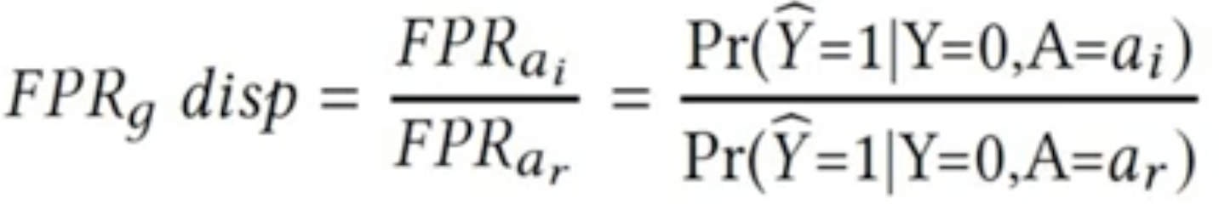
Parity Measures
Compare a given metric with a reference group
Bias measured as disparity between group metrics
Notes:
The way we measure fairness is based on PARITY. We compare one measure of choice between two groups.
Great for communication: “You make 3x more mistakes for innocent people that are non-white vs white”.

Slide 32
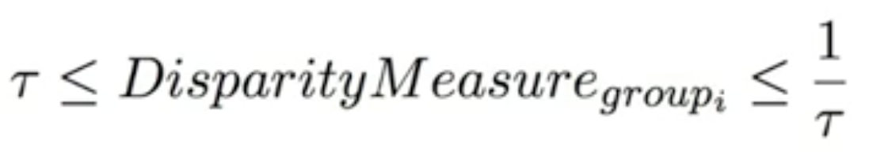
Parity Notion of Fairness
This notion requires that all biases (disparities) be within the range defined by the fairness threshold.
Example: If the fairness threshold is 0.8, the fairness range is between 80% and 125% of the group metric value of the selected reference group."
Notes:
The way we measure fairness is based on PARITY. We compare one measure of choice between two groups.
Great for communication: “You make 3x more mistakes for innocent people that are non-white vs white”.

Slide 33
Are your interventions punitive or assistive?
punitive
(could hurt individuals)
assistive
(could hurt individuals)
FDR parity
FP parity
FPR parity
FOR parity
FN parity
FNR parity

Slide 34
Famous Misconceptions

Slide 35
No “Fairness through Unawareness”
Shall I use race or gender in my models? Remove protected attributes?
Well, other features subsume the protected attributes.
Example: “Easy to predict gender based on Facebook likes."
Notes:
The way we measure fairness is based on PARITY. We compare one measure of choice between two groups.
Great for communication: “You make 3x more mistakes for innocent people that are non-white vs white”.

Slide 36
No “Fairness through Demographic Parity”
Example: Accept the same % of women and men for the job as the % of women and men in the population (city? country? candidates pool?)
Decision to be independent from the protected attribute?
Does not ensures “supervised fairness”, as it is possible to have different false positive/negative parities across groups.
Cripples the overall utility metric (e.g. A correlated with Y)
Notes:
This is not fair because it is not conditioned on label so you are just pushing Negative examples up top (crippling overall performance).
You still want good overlap performance. Secondary goal -> i care about biases and fairness of my models.

Slide 37
Fairness Tradeoffs
If the base rate (prevalence) is different between groups and the classifier is non-trivial (Recall>0) and imperfect (FPR > 0). Then, either:
Precision Parity Fails (same as FDR parity)
FPR and Recall (same as FNR) will be disparate (no equalized odds)
[Kleinberg16, Chouldechova17]
Notes:
This is not fair because it is not conditioned on label so you are just pushing Negative examples up top (crippling overall performance).
You still want good overlap performance. Secondary goal -> i care about biases and fairness of my models.

Slide 38
Practice Time
https://github.com/dssg/aequitas

Slide 39
Optimizing Threshold for Business
When you can estimate the economic impact of a FP and a TP
Notes:
This is not fair because it is not conditioned on label so you are just pushing Negative examples up top (crippling overall performance).
You still want good overlap performance. Secondary goal -> i care about biases and fairness of my models.

Slide 40
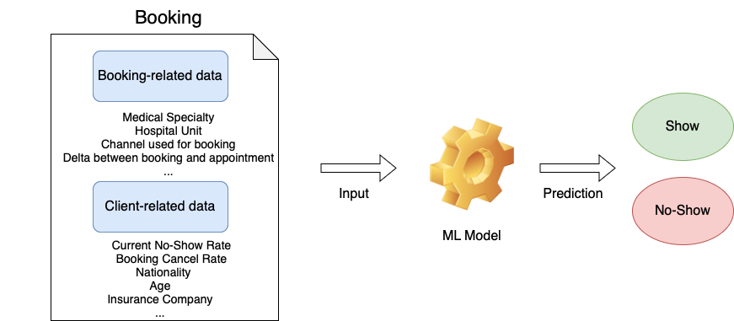
Case Study: Predicting No-Shows in Hospital bookings
Apply intervention
Notes:
This is not fair because it is not conditioned on label so you are just pushing Negative examples up top (crippling overall performance).
You still want good overlap performance. Secondary goal -> i care about biases and fairness of my models.

Slide 41
Case Study: Predicting No-Shows in Hospital bookings
Cost of a (False) Positive
Cost of intervention – 2€
Cost of a False Negative (default)
Resources allocated and wasted – 30€
Opportunity of a True Positive
Profit – 20€
Let’s be realistic
Intervention Success rate
Notes:
This is not fair because it is not conditioned on label so you are just pushing Negative examples up top (crippling overall performance).
You still want good overlap performance. Secondary goal -> i care about biases and fairness of my models.

Slide 42
Case Study: Predicting No-Shows in Hospital bookings
How to find the best decision threshold?
For each threshold:
Obtain confusion matrix
Compute (expected) savings vs default
Intervention
success rate
benefit - cost
Notes:
This is not fair because it is not conditioned on label so you are just pushing Negative examples up top (crippling overall performance).
You still want good overlap performance. Secondary goal -> i care about biases and fairness of my models.

